Slide 1

CSS Units, Gradients, Selectors & Transitions/Transforms
Sit Dolo Amet

Slide 2
Some imp CSS units
CSS units define measurement values
2 main types:
Absolute units (px, cm, etc.)
Relative units (em, rem, vh, vw, %)

Slide 3
Linear Gradient
Creates smooth transitions between colors
Top to Bottom: linear-gradient(to bottom, red, yellow)
Left to Right: linear-gradient(to right, blue, green)
Diagonal: linear-gradient(45deg, purple, pink)

Slide 4
CSS Selectors (Combinators)
Descendant (space) → div p (all p inside div)
Child (>) → div > p (direct child only)
Adjacent (+) → h1 + p (p immediately after h1)
General sibling (~) → h1 ~ p (all p after h1)

Slide 5
CSS Transforms
• Allows scaling, rotating, skewing elements
• Properties:
rotate()
scale()
skew()
translate()

Slide 6
Transition Properties
transition-property (e.g., background-color)
transition-duration (e.g., 2s)
transition-delay (e.g., 1s)
transition-timing-function (ease, linear, ease-in, ease-out, cubic-bezier)

Slide 7
Definition: Transitions allow changes in CSS properties to happen smoothly (animated), instead of instantly.
Example: Without transition → background changes instantly With transition → background fades smoothly

Slide 8
transition-timing-function
• Controls the speed curve of the animation.
• Common values:
linear → same speed
ease → slow → fast → slow (default)
ease-in → starts slow, then fast
ease-out → fast, then slow
ease-in-out → slow → fast → slow
• You can also use cubic-bezier() for custom curves.

Slide 9
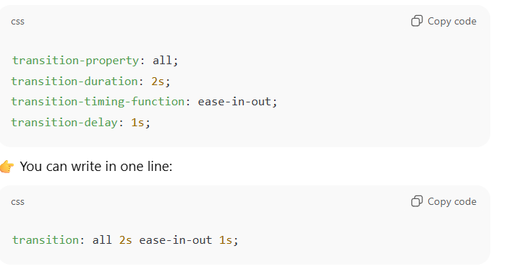
Shorthand

Slide 10
Real-World Uses
Button hover effects
Dropdown menus
Image zoom on hover
Card animations (rotate, scale, fade)

